Slide 1
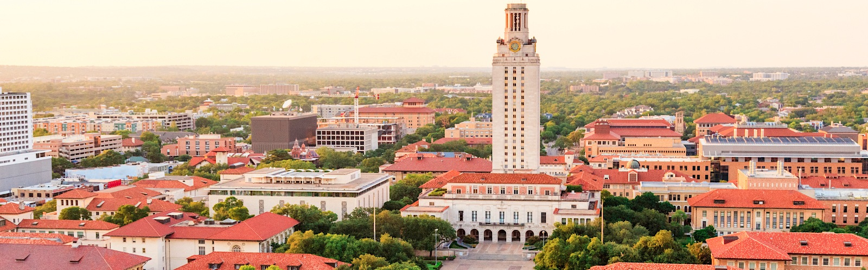


Statistical Analysis and Learning (SAL): Support Vector Machines, ISL Ch9 Textbook: An Introduction to Statistical Learning (ISL)
Varun Rai
LBJ School of Public Affairs
The University of Texas at Austin
11th April 2018

Slide 2
Note on Material
Unless otherwise noted, all material in this presentation are from this course’s textbook, An Introduction to Statistical Learning (ISL)

Slide 3
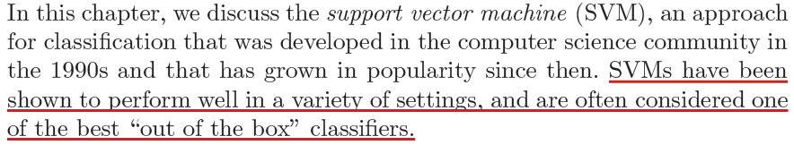
Support Vector Machine (SVM)

Slide 4
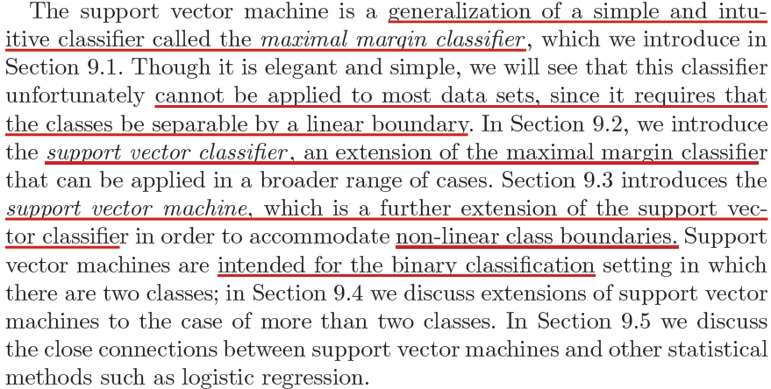
Support Vector Machine (SVM)

Slide 5
Maximal Margin Classifier

Slide 6
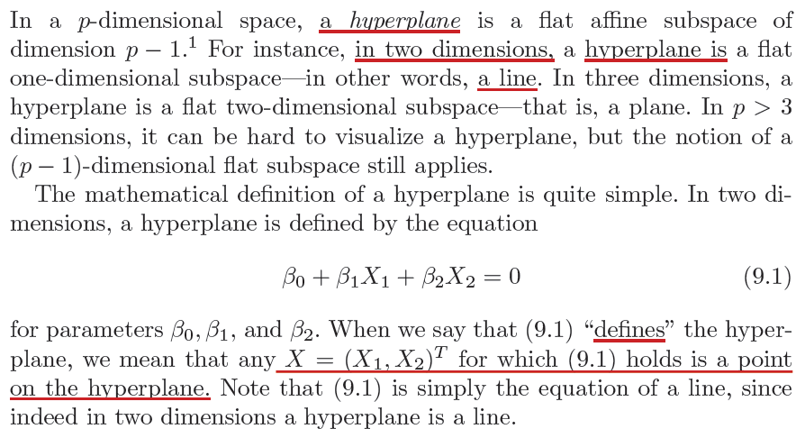
What is a Hyperplane?

Slide 7
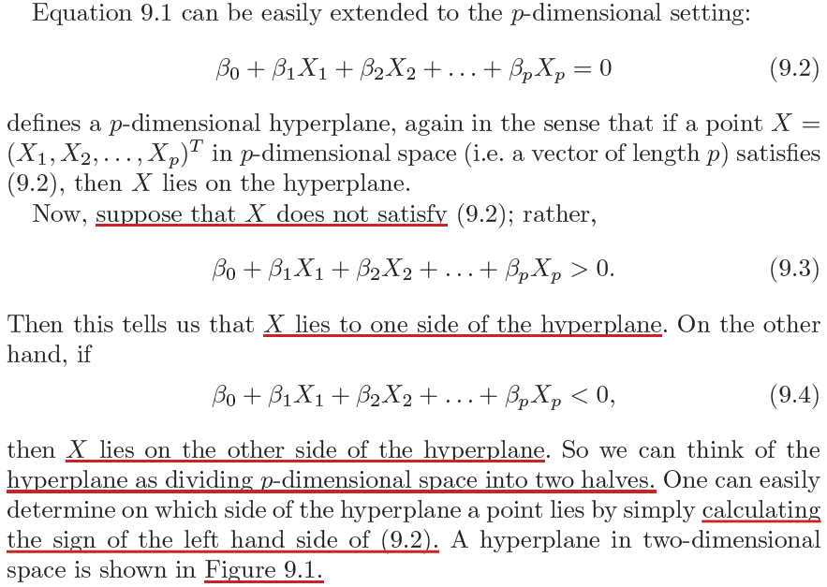
What is a Hyperplane?

Slide 8
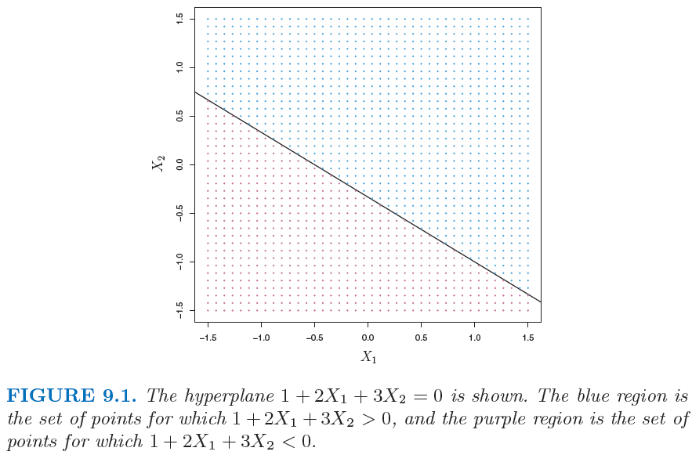
What is a Hyperplane?

Slide 9
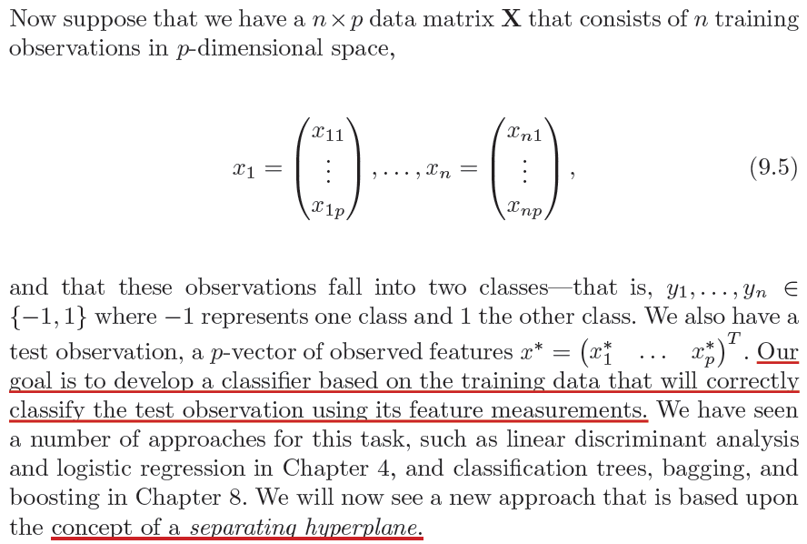
Classification Using a Separating Hyperplane

Slide 10
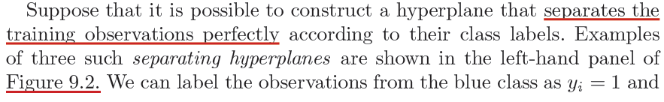
Classification Using a Separating Hyperplane

Slide 11
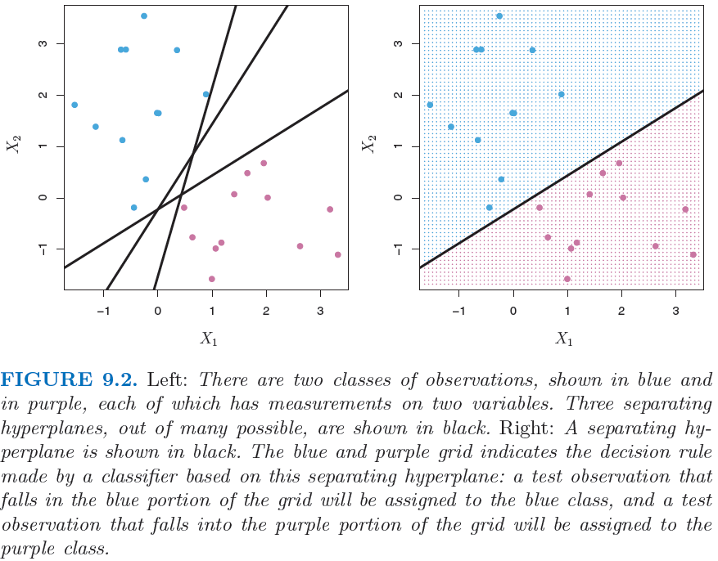
Classification Using a Separating Hyperplane

Slide 12
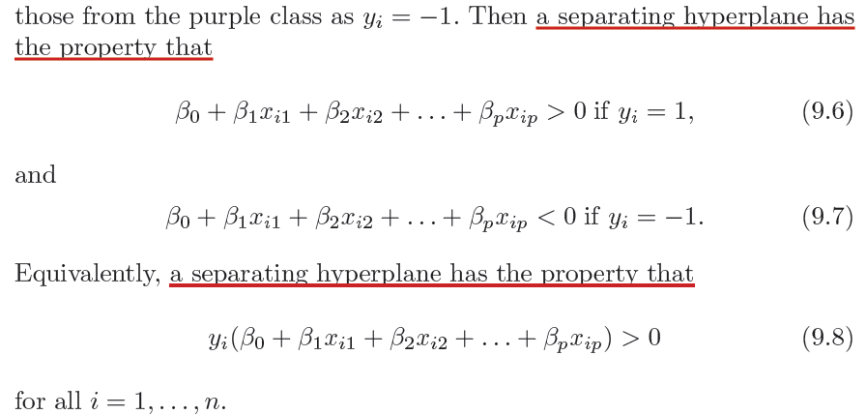
Classification Using a Separating Hyperplane

Slide 13
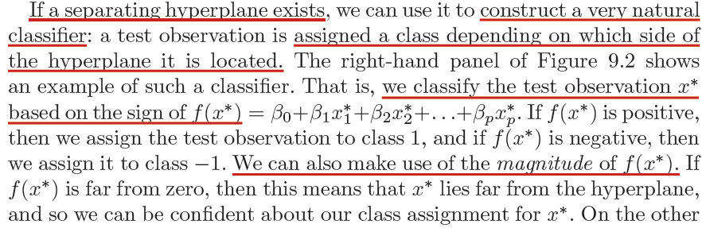
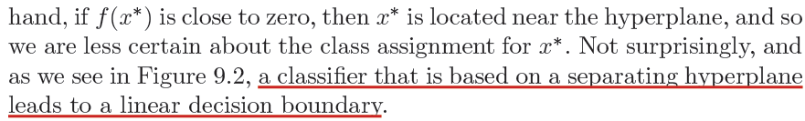
Classification Using a Separating Hyperplane

Slide 14
Classification Using a Separating Hyperplane

Slide 15
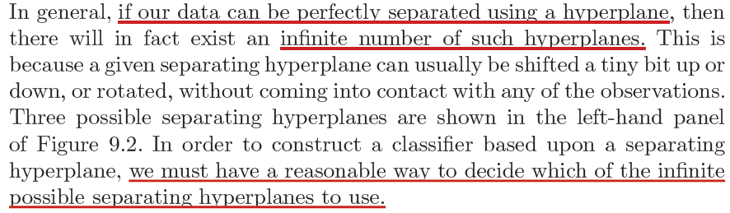
The Maximal Margin Classifier

Slide 16
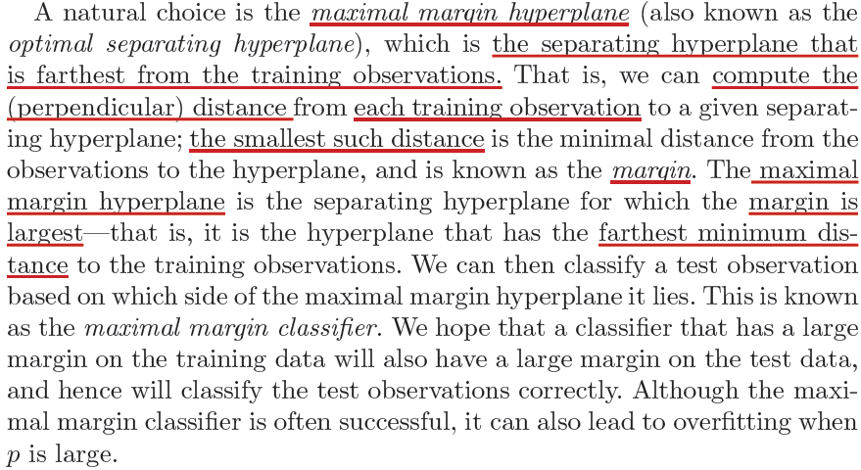
The Maximal Margin Classifier

Slide 17
The Maximal Margin Classifier

Slide 18
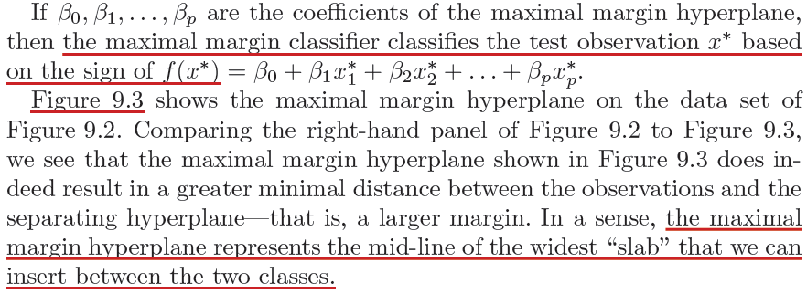
The Maximal Margin Classifier

Slide 19
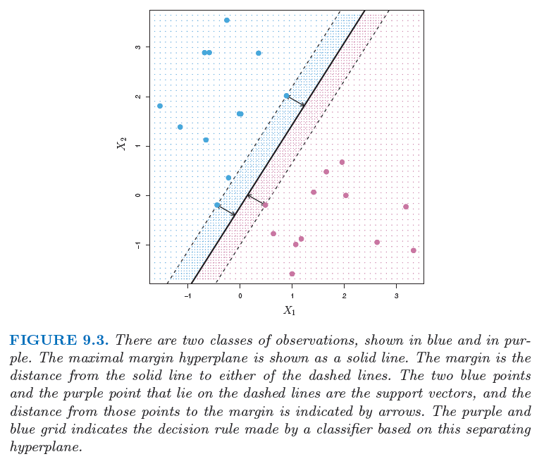
The Maximal Margin Classifier
Three support vectors

Slide 20
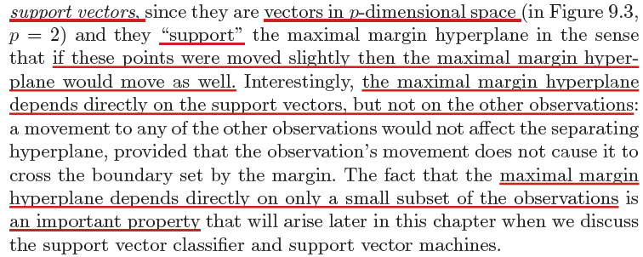
The Maximal Margin Classifier: Support Vectors

Slide 21
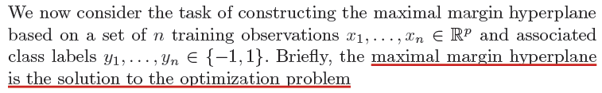
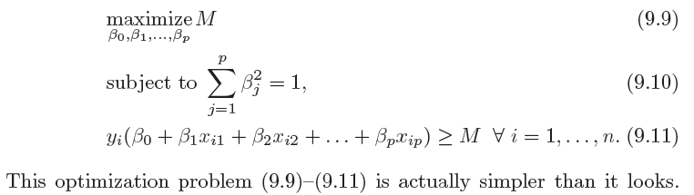
The Maximal Margin Classifier: Construction

Slide 22
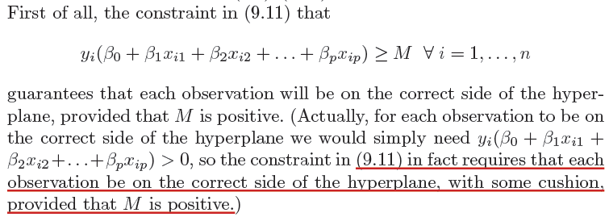
The Maximal Margin Classifier: Construction

Slide 23
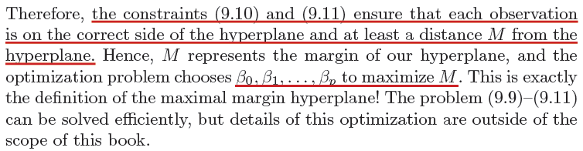
The Maximal Margin Classifier: Construction
Notes:
End of session 1.

Slide 24
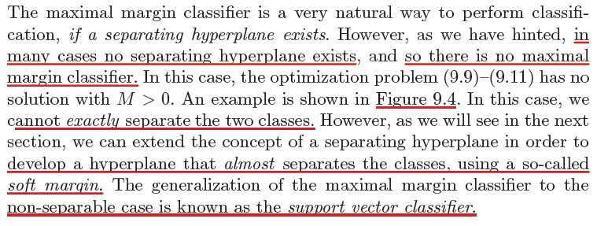
The Non-Separable Case
Notes:
Begin session 2

Slide 25
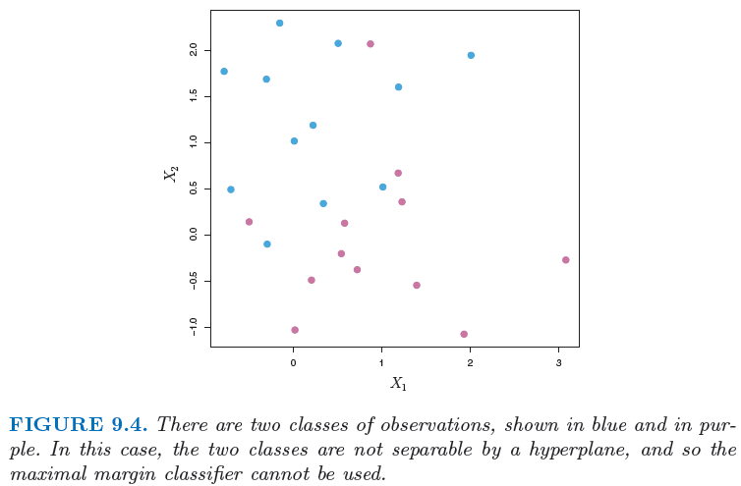
The Non-Separable Case

Slide 26
The Non-Separable Case
Notes:
Begin session 2

Slide 27
Support Vector Classifier

Slide 28
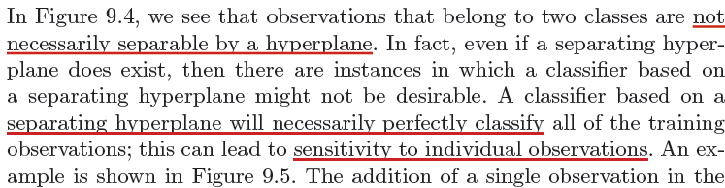
Overview of Support Vector Classifier

Slide 29
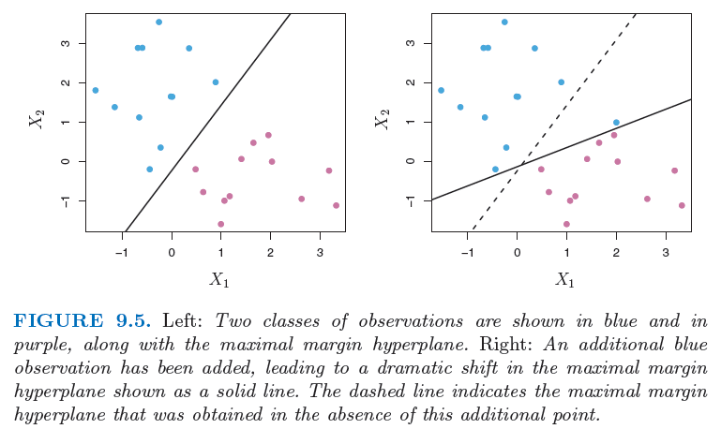
Overview of Support Vector Classifier

Slide 30
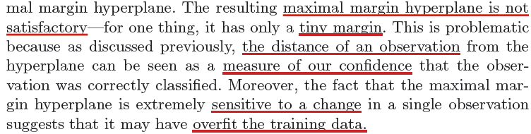
Overview of Support Vector Classifier

Slide 31
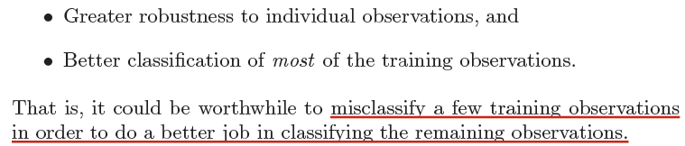
Overview of Support Vector Classifier

Slide 32
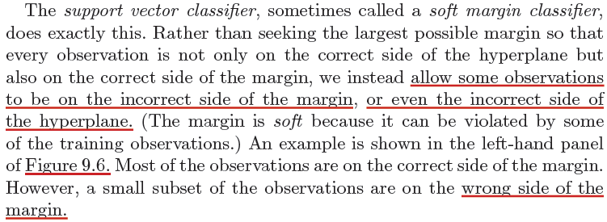
Overview of Support Vector Classifier

Slide 33
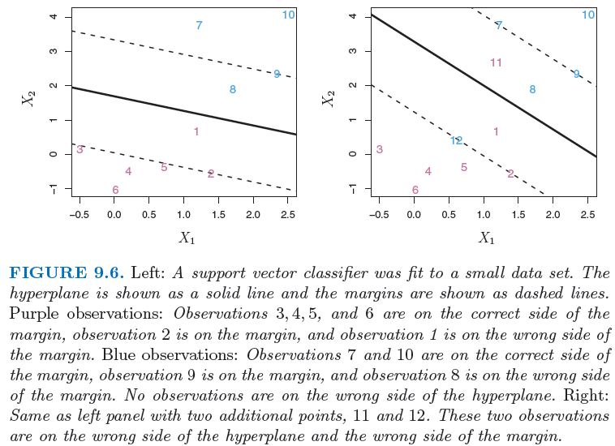
Overview of Support Vector Classifier

Slide 34
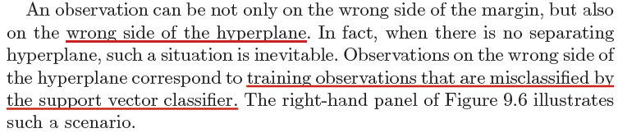
Overview of Support Vector Classifier

Slide 35
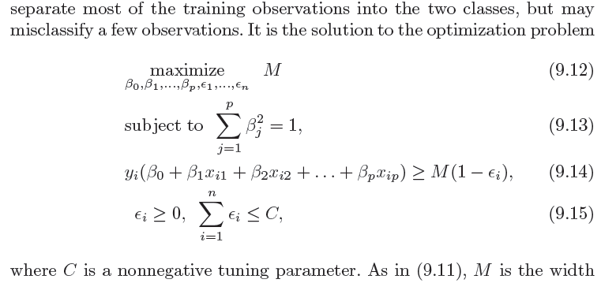
Support Vector Classifier Optimization

Slide 36
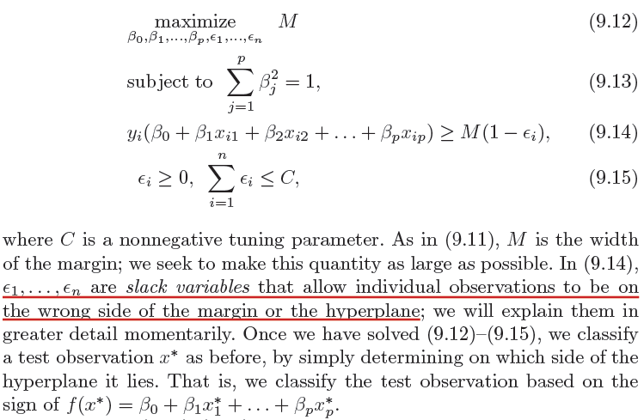
Support Vector Classifier: Slack Variables

Slide 37
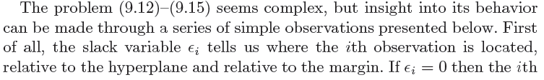
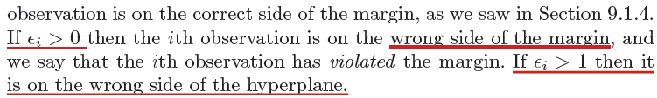
Support Vector Classifier: Slack Variables

Slide 38
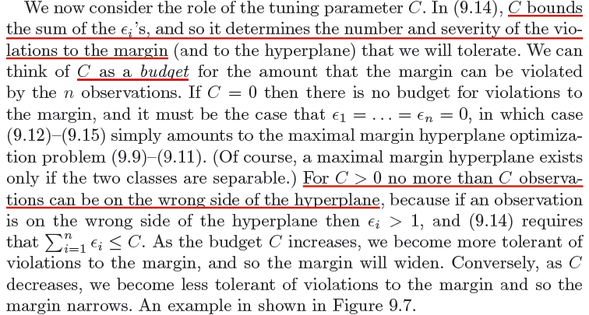
Support Vector Classifier: “Budget”

Slide 39
Support Vector Classifier: “Budget”

Slide 40
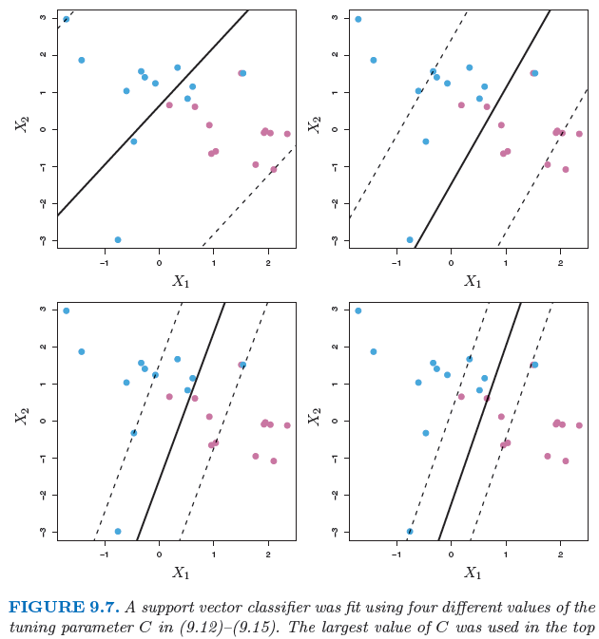

Slide 41
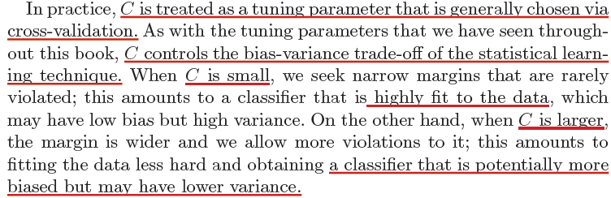
Support Vector Classifier: Bias-Variance
How do you expect the bias-variance trade-off to shift as the value of C goes from small to large?

Slide 42
Support Vector Classifier: Bias-Variance

Slide 43
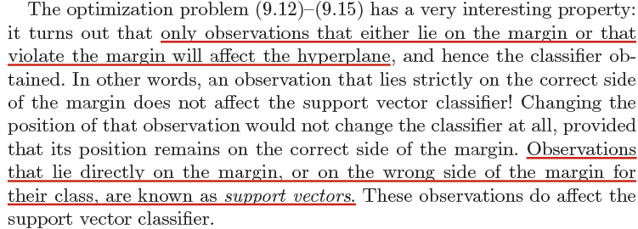
Support Vector Classifier: Support Vectors

Slide 45
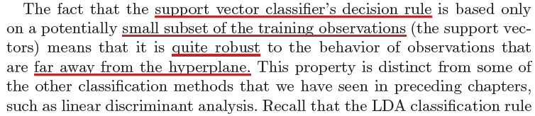
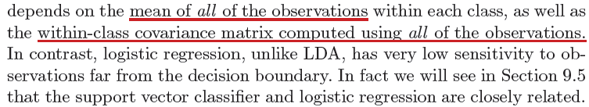
Support Vector Classifier: Sensitivity
Notes:
End of session 2

Slide 46
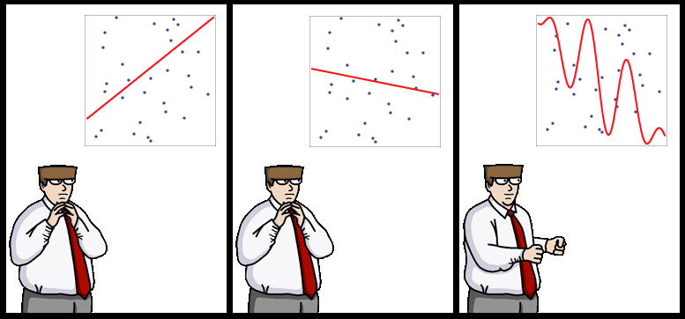
End of Lecture #11
Source: http://yaroslavvb.blogspot.com/

Slide 47
Support Vector Machines

Slide 48

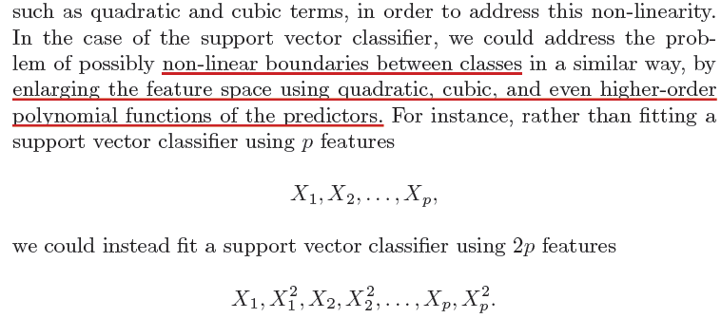
Classification with Non-Linear Decision Boundary

Slide 49
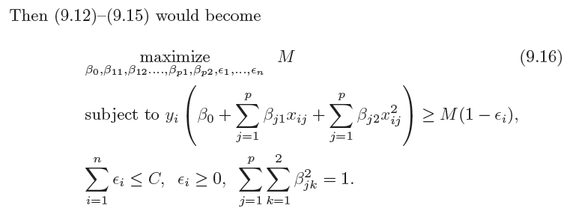
Classification with Non-Linear Decision Boundary

Slide 50
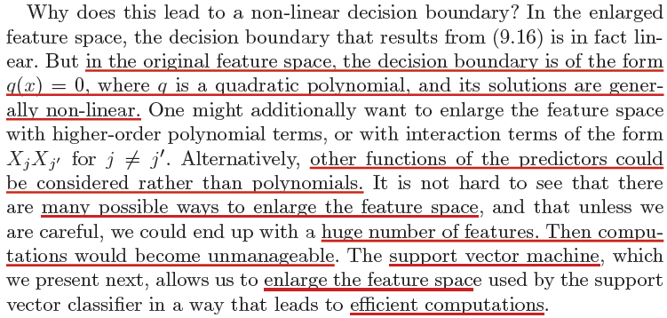
Classification with Non-Linear Decision Boundary

Slide 51
Classification with Non-Linear Decision Boundary

Slide 52
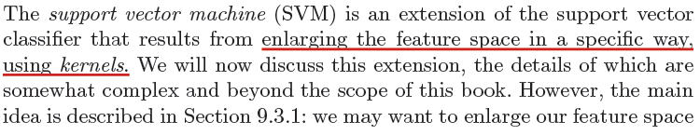

The Support Vector Machine (SVM)

Slide 53
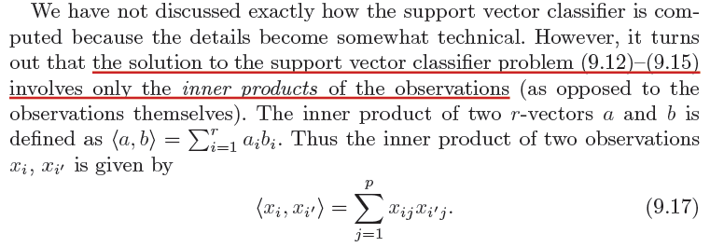
The Support Vector Machine (SVM)

Slide 54
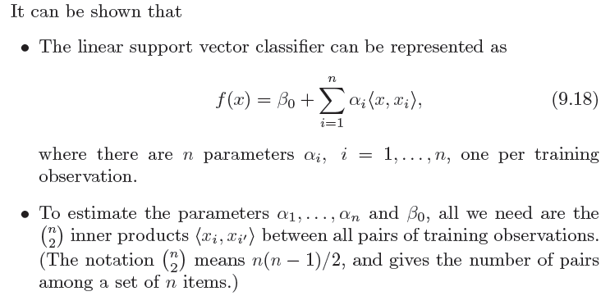
The Support Vector Machine (SVM)

Slide 55

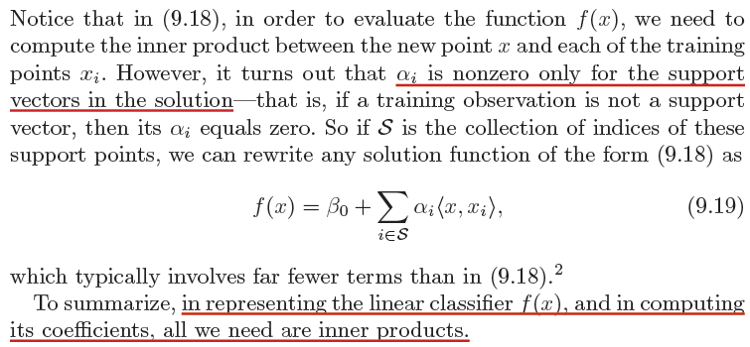
The Support Vector Machine (SVM)

Slide 56
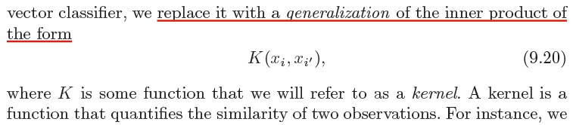
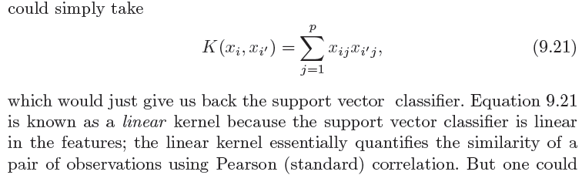
The Support Vector Machine (SVM)

Slide 57


The Support Vector Machine (SVM)

Slide 58

The Support Vector Machine (SVM)

Slide 59


The Support Vector Machine (SVM): Radial Kernel

Slide 60

The Support Vector Machine (SVM)
Notes:
The margin is inside the dotted circles.

Slide 61


The Support Vector Machine (SVM): Radial Kernel

Slide 62
End of Lecture #12
Source: http://yaroslavvb.blogspot.com/

